Slide 1
Dynamics

Slide 2

Relative velocity
3.37 A “moving sidewalk” in an airport terminal building moves at 1.0 m/s and is 35.0 m long. If a woman steps on at one end and walks at 1.5 m/s relative to the moving sidewalk, how much time does she require to reach the opposite end if she walks (a) in the same direction the sidewalk moving?
Let W stand for the woman, G for the ground, and S for the sidewalk. Take the positive direction to be the direction in which the sidewalk is moving. The velocities are: woman relative to ground v_{WG}, woman relative to sidewalk v _{WS}, Sidewalk relative to ground v_{SG}.
(b) In the opposite direction?

Slide 3
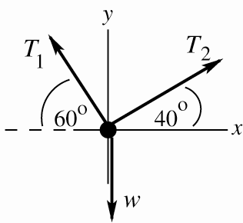
5.61. Two ropes are connected to a steel cable that supports a hanging weight as shown in Fig. (a) Draw a free-body diagram showing all of the forces acting at the knot that connects the two ropes to the steel cable. Based on your force diagram, which of the two ropes will have the greater tension?
60º
40º
(b) If the maximum tension either rope can sustain without breaking is 5.0 kN, determine the maximum value of the hanging weight that these ropes can safely support. You can ignore the weight of the ropes and the steel cable.

Slide 4
4.16 An electron (mass=9.11×10⁻³¹kg) leaves one end of a TV picture tube with zero initial speed and travels in a straight line to the accelerating grid, which is 1.80 cm away. It reaches the grid with a speed of 3.00×10⁶ m/s. If the accelerating force is constant, compute (a) the acceleration;
(b) the time to reach the grid;
(c) the net force. You can ignore the gravitational force on the electron.

Slide 5
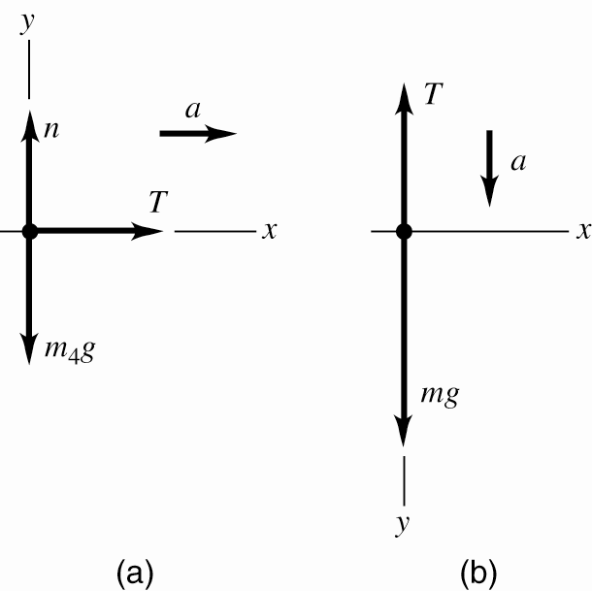
5.21 A light rope is attached to a block with mass 4.00 kg that rests on a frictionless, horizontal surface. The horizontal rope passes over a frictionless, massless pulley, and a block with mass m is suspended from the other end. When the blocks are released, the tension in the rope is 10.0 N. (a) Draw two free-body diagrams, one for the 4.00-kg block and one for the block with mass m.
(b) What is the acceleration of either block?
(c) Find the mass m of the hanging block.
(d) How does the tension compare to the weight of the hanging block?

